Slide 1
CSJ Advisory Board for Student Organizations
Andrew Ward, Chair
Savitha Krishnan, Treasurer
February 24, 2019
Notes:
Introductions: year, school, major, how many years on ABSO

Slide 2
Who we are
what we do
who we impact
& who we serve

Slide 3
Who are we?
CSJ ABSO is made up of twelve (12) voting student members, two (2) voting staff members, and one (1) non-voting CSJ Staff Advisor
Voting Staff Advisors include Professor Marcus Board, Assistant Professor in African American Studies and
Phylander Pannell, Director of Georgetown Event Management Services (GEMS)
The Board oversees, evaluates, advises and funds student-run organizations whose missions are in line with that of Georgetown University’s Center for Social Justice Research, Teaching and Service (CSJ).
Although the Board seeks to advance the CSJ’s mission to “advance justice and the common good,” ABSO exists as an entirely separate entity from the CSJ and receives no funding from the CSJ.
ABSO prides itself on fostering a space where student leaders can make real decisions that affect real people all while striving for justice and the common good on the Hilltop and beyond.
Notes:
Andrew

Slide 4
What do we do?
Currently, forty (40) student organizations work with CSJ ABSO student board members to ensure compliance with university policies, access funding for on-campus and off-campus programming, learn about university resources and spaces, develop long and short term goals, discern organization values and mission, and plan for leadership transition and organization continuity.
Additionally, CSJ ABSO advises six (6) student organizations currently in the New Club Development Process.
CSJ ABSO meets weekly on Tuesdays at 6:00pm to engage in social justice reflection, consider Ad-Hoc Funding Requests, and discuss short and long-term goals.
Notes:
Savi

Slide 5
Who do we impact on campus?
In total, CSJ ABSO Student Organizations impact about one thousand (1,000) Georgetown students every year.
CSJ ABSO empowers Georgetown student leaders to organize and direct their own student organizations and request funding and approvals for events on and off the Hilltop
CSJ ABSO’s funding policies provide funding for general body meetings, a minimum of two of which are required each semester, retreats, at which organization members may reflect on the work they are doing and the mission they are fulfilling, and group bonding activities, where organization members may form friendships with each other outside of their regular mission-based activities.
Notes:
Andrew

Slide 6
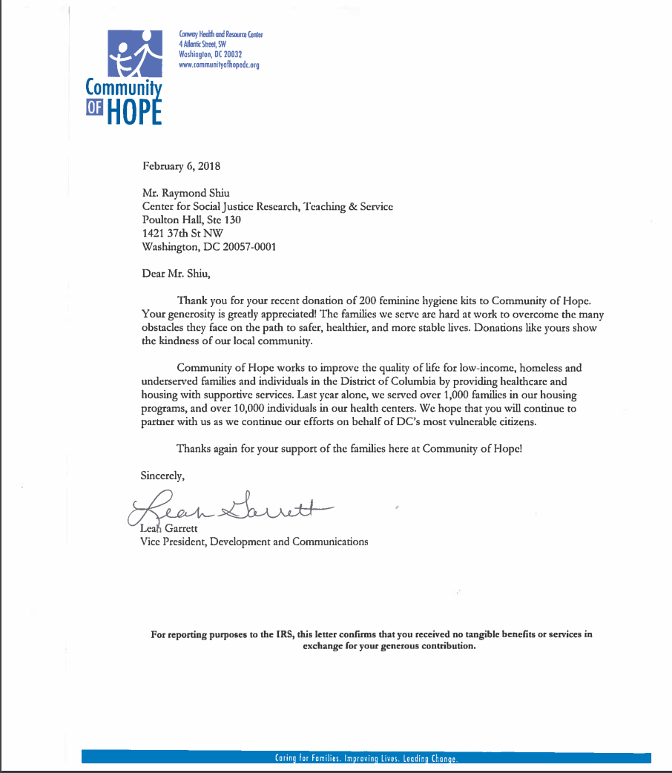
Who do we serve off-campus?
CSJ ABSO student organizations tirelessly work to advance justice and the common good by working hand-in-hand with community partners in DC and beyond.
ABSO’s student organization have reached, quite literally, tens of thousands of individuals in the DC Community, around the United States, and abroad.
Notes:
Savi

Slide 7
Group Highlights

Slide 8
Group Highlight: Period Empowerment Project
Period Empowerment Project (PEP) became an access to benefits group in Fall 2018
PEP’s mission is raise awareness on Georgetown’s campus surrounding access to feminine hygiene products in marginalized communities
PEP’s on-campus programming includes:
Dialogue on Menstrual Stigma (November 7, 2018)
Hoya Hub Hygiene Product Package Assembly
PEP’s off-campus programming includes:
Holding feminine hygiene product drives and purchasing products to prepare care packages
Donating care packages to local women’s shelters
Notes:
Savi

Slide 9
Group Highlight: Georgetown Ballers
Georgetown Ballers became an access to benefits group in Fall 2018
Georgetown Ballers runs a mentorship program with incarcerated youth at DC’s youth detention center that combines character formation exercises with basketball games between Georgetown students and center inmates
In addition to their off-campus programming, Georgetown Ballers hosts on-campus awareness events to draw attention to juvenile justice issues
Events include discussions with Georgetown Law Center professors who run the Law Center’s Juvenile Justice Clinic
Georgetown Ballers has plans to expand programming to two (2) weekly visits and to partner with Georgetown’s Men’s Basketball Team
Notes:
Andrew

Slide 10
Nuts and Bolts

Slide 11
CSJ ABSO’s Funding Policies
The Board prides itself on its Ad-Hoc funding scheme that allows student organizations to increase their impact on Georgetown’s campus and better fulfill their missions by adding events and requesting additional funds for programming from CSJ ABSO during the year
New Features for FY20
Healthy Food Option Incentive
Mission-Based Vendor Incentive
Eco-Friendly Policy
Notes:
Andrew

Slide 12
Reserves
ABSO’s Reserve Account Balance is $103, 873.14
At the close of FY17, the balance was $67,000.00
At the close of FY18, the balance increased by an additional $37,000.00
The CSJ Finance Team did not communicate these large increases in CSJ ABSO’s Reserve Account
At the opening of FY19, CSJ Finance Staff miscommunicated the balance of the account to be within Student Affairs Policy of $30,000.00
In CSJ ABSO’s initial application, it offered a solution to spend down its Reserve Account
However, if the Committee does not require that CSJ ABSO spend down its Reserve Account, CSJ ABSO has on-going projects that would benefit from increased funds
Examples include: Needs Assessment for 60+ Community Partners or sustainability efforts
Notes:
Andrew

Slide 13
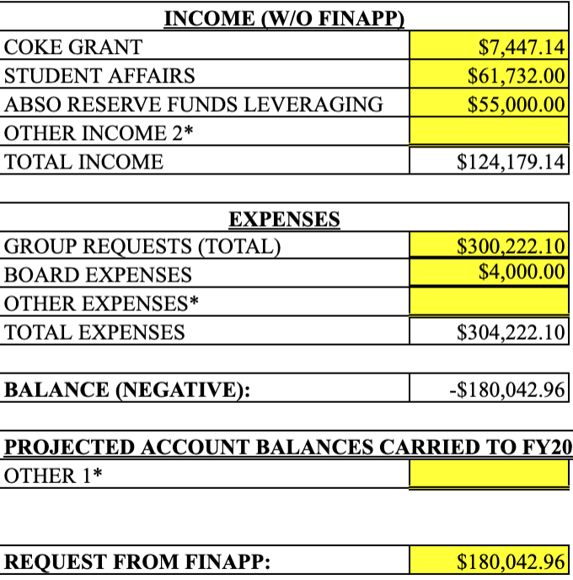
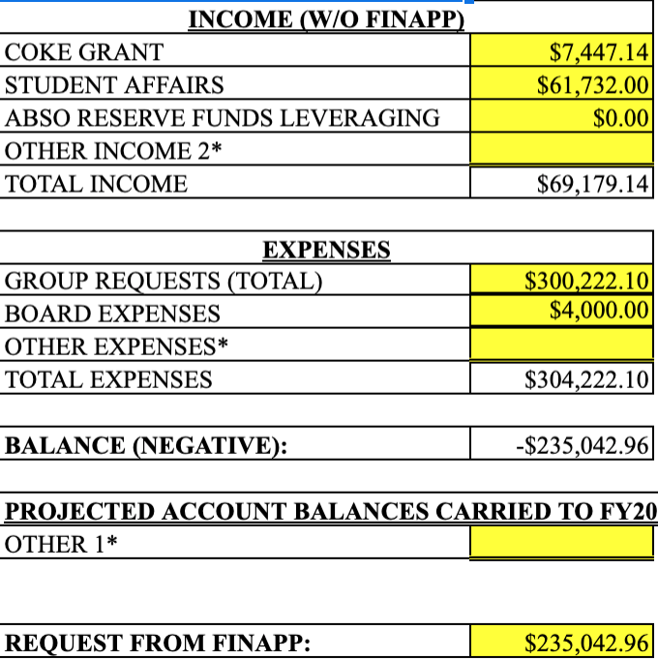
Amended Total Funding Request
Original Total Funding Request
Amended Total Funding Request
Notes:
Savi

Slide 14
Thank you for your time.
Questions?

